Slide 1

Chapter 3
Vectors and Motion in Two Dimensions

Slide 2
Major Topics
Components of Vectors
Vector Addition and Subtraction
The Acceleration Vector
Projectile Motion
Circular Motion
Relative Motion

Slide 3
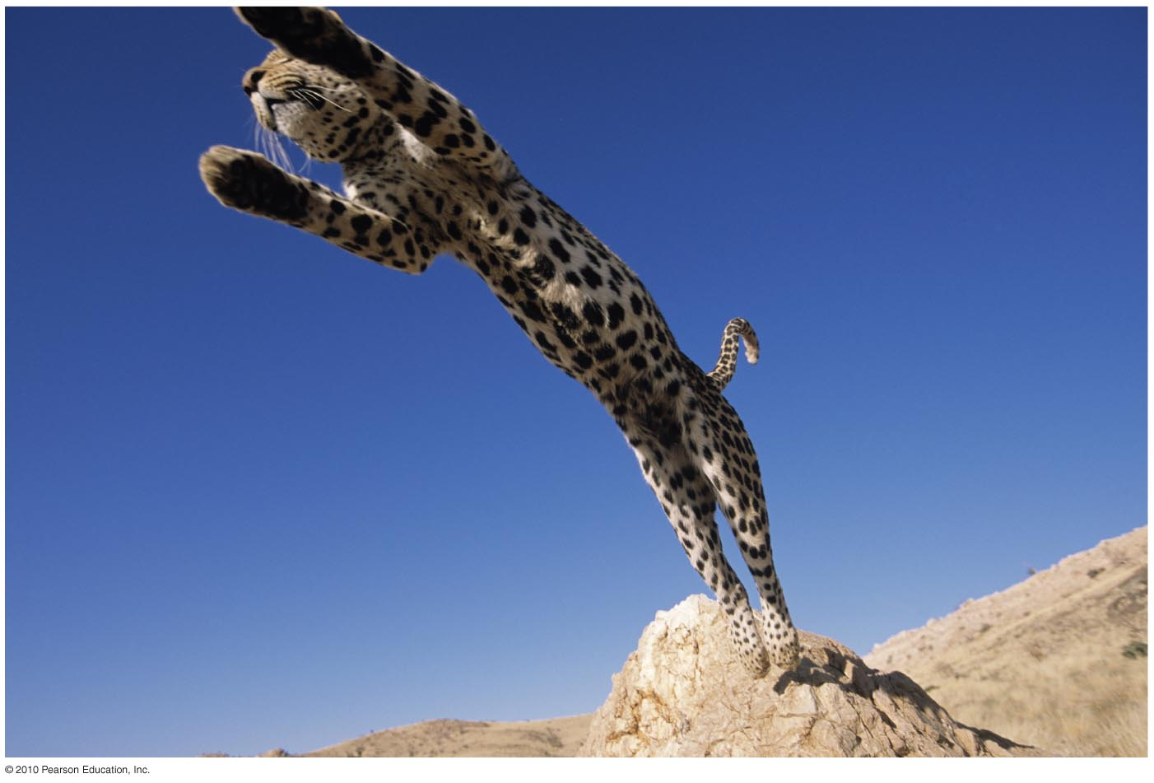
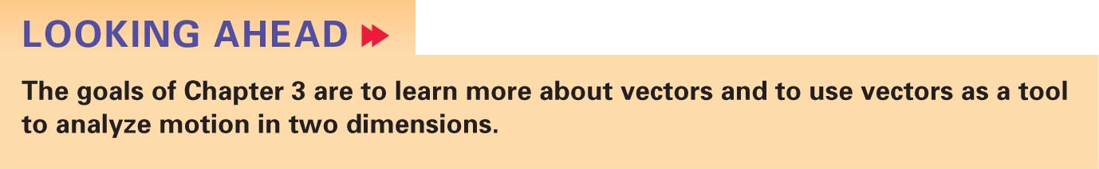

3 Vectors and Motion in Two Dimensions
Slide 3-2

Slide 4
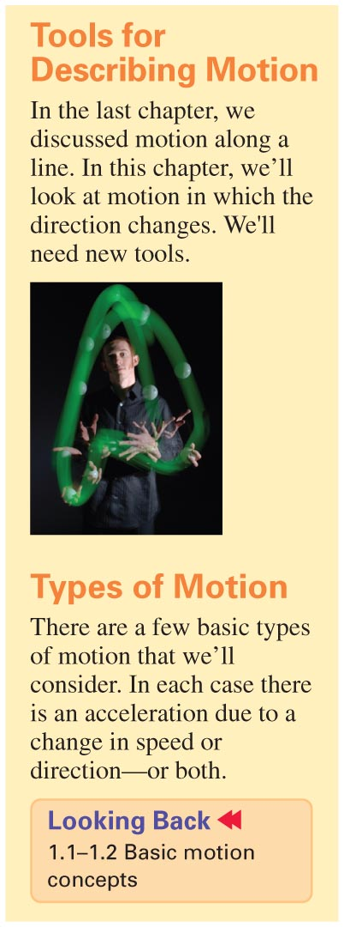
Slide 3-3

Slide 5
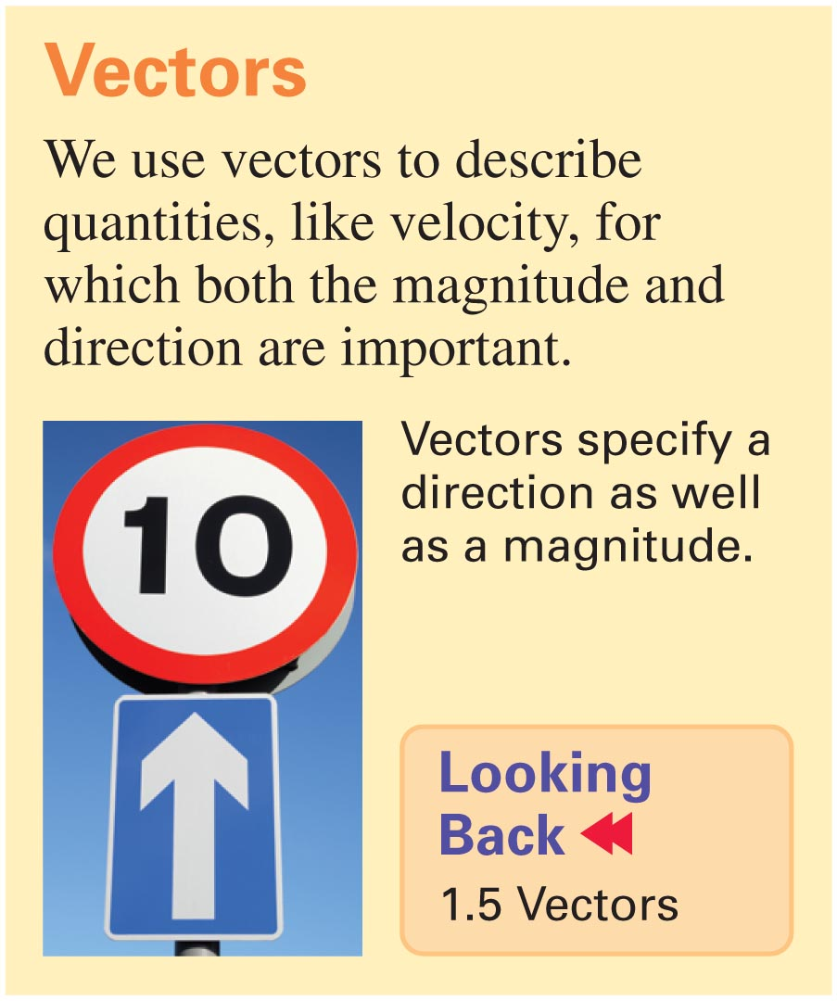
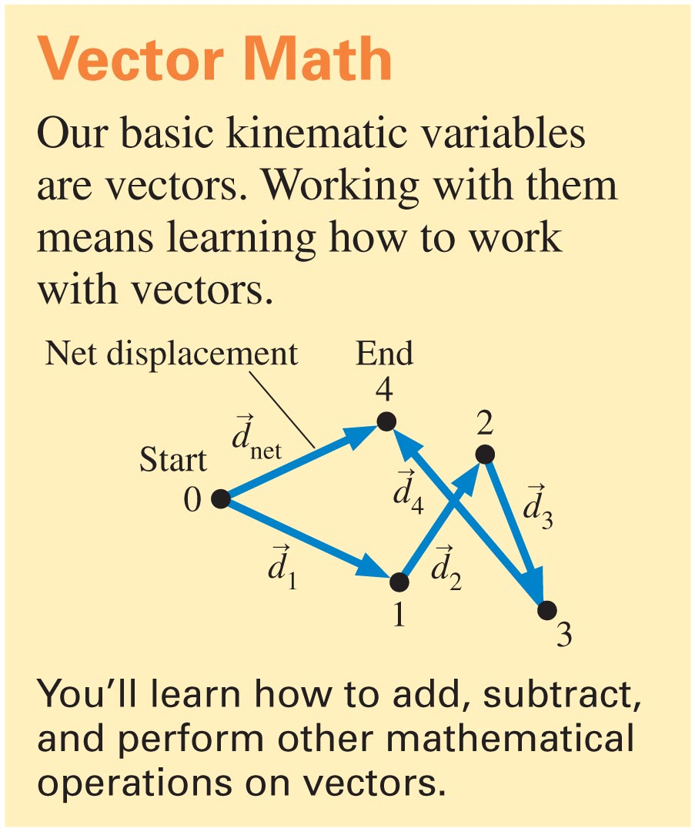
Slide 3-4

Slide 6
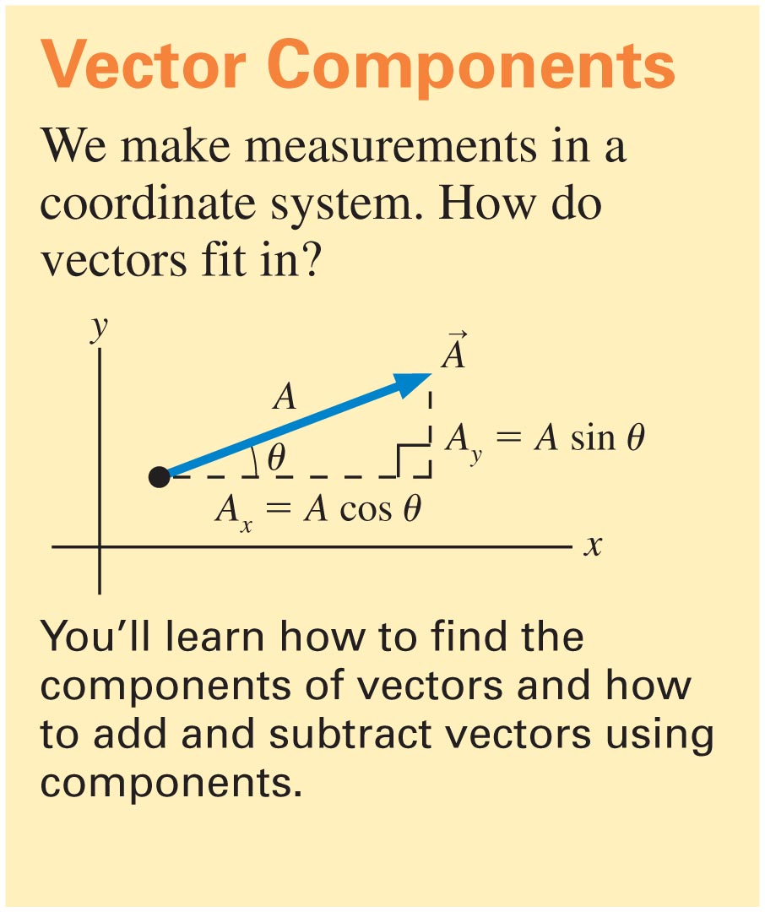
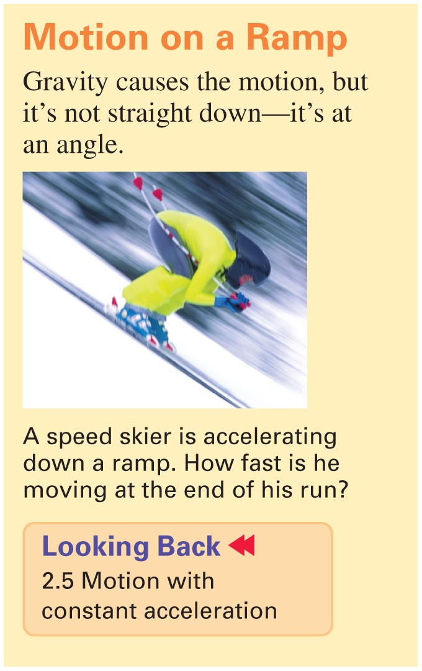
Slide 3-5

Slide 7
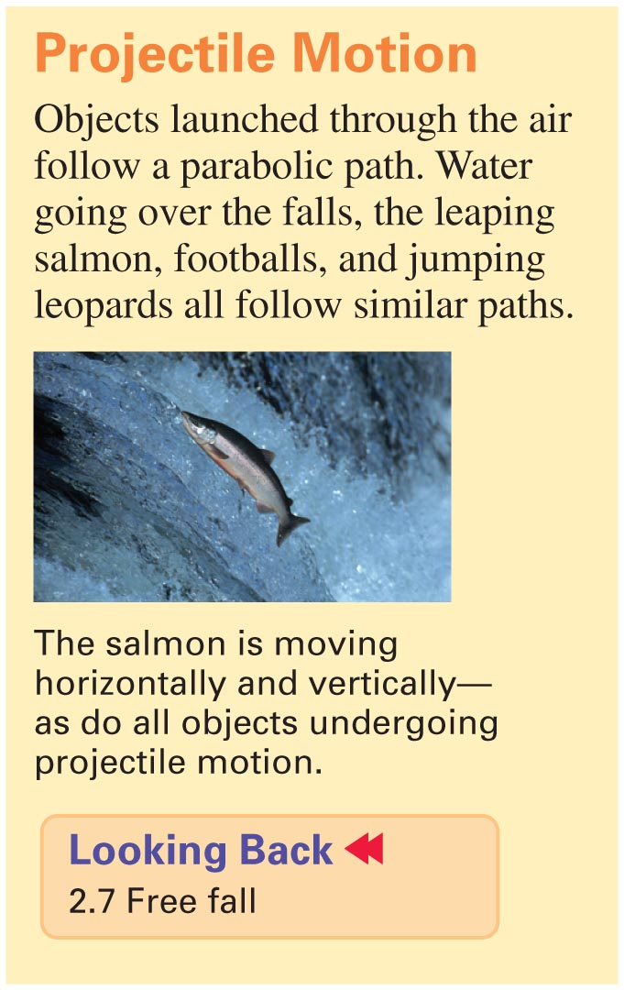
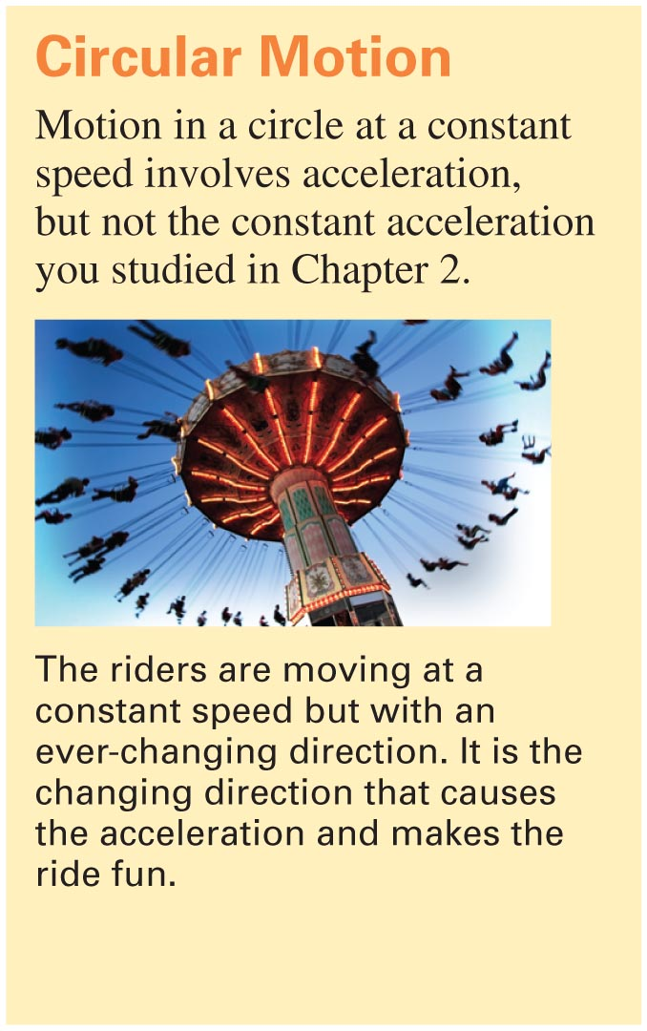
Slide 3-6

Slide 8
Vectors
A vector has both magnitude and direction
Would a vector be a good quantity to represent the temperature in a room?

Slide 9
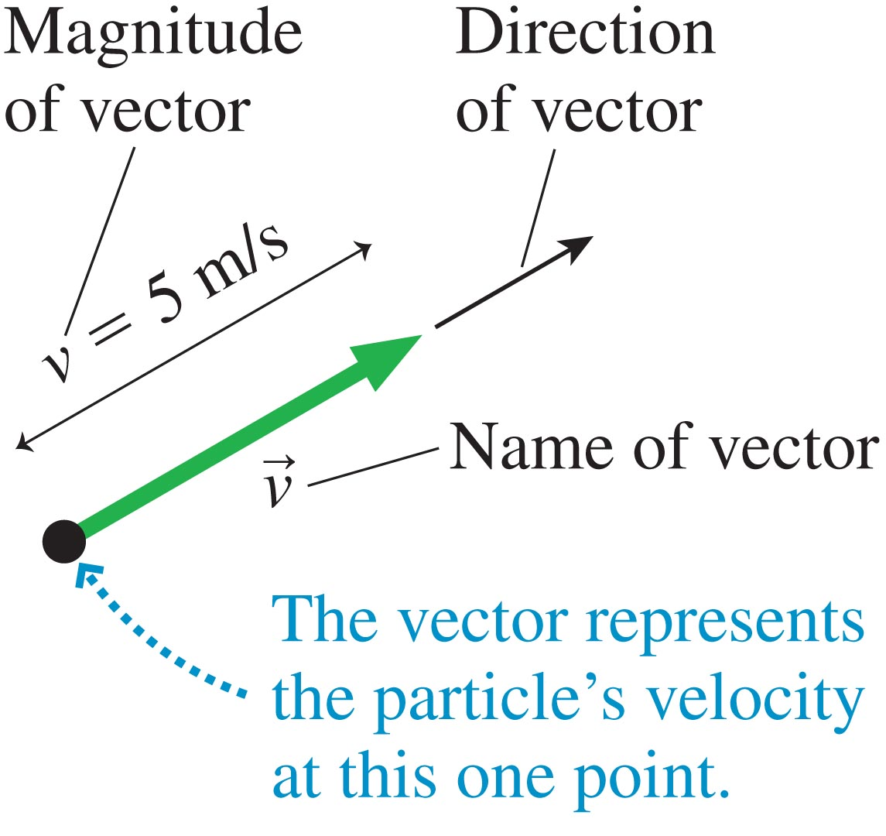
Vectors
Slide 3-13

Slide 10

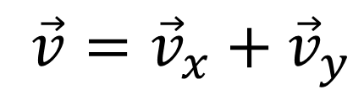
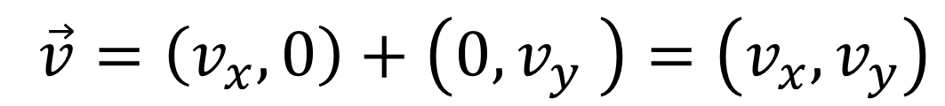
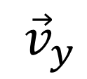
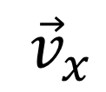
Coordinate systems
Component Vectors
$$\vec{v}$$
$${\vec{v}}_{y}$$
$$\vec{v}={\vec{v}}_{x}+{\vec{v}}_{y}$$
$${\vec{v}}_{x}$$
$$\vec{v}=\left(v_{x},0\right)+\left(0,v_{y} \right)=\left(v_{x},v_{y}\right)$$

Slide 11
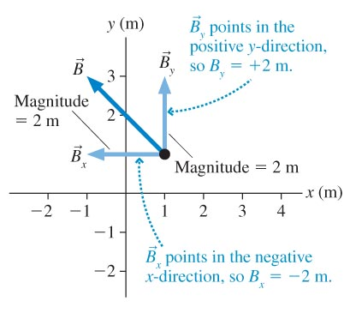
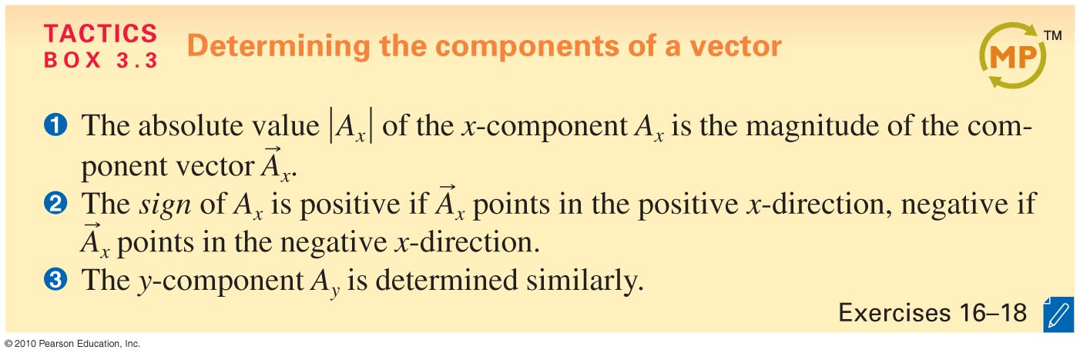
Components of Vectors
Slide 3-22

Slide 12



Vectors have components
Projections onto an orthogonal coordinate system
$$\vec{V}$$
$$y\text{−}\text{component} \text{of} \vec{V}$$
$$x\text{−}\text{component} \text{of} \vec{V}$$

Slide 13

Reading Quiz
→
1. A_{x} is the __________ of the vector A.
A. magnitude
B. x-component
C. direction
D. size
E. displacement
Slide 3-7
Notes:
Answer: B

Slide 14
Answer
→
1. A_{x} is the __________ of the vector A.
A. magnitude
B. x-component
C. direction
D. size
E. displacement
Slide 3-8
Notes:
Answer: B

Slide 15
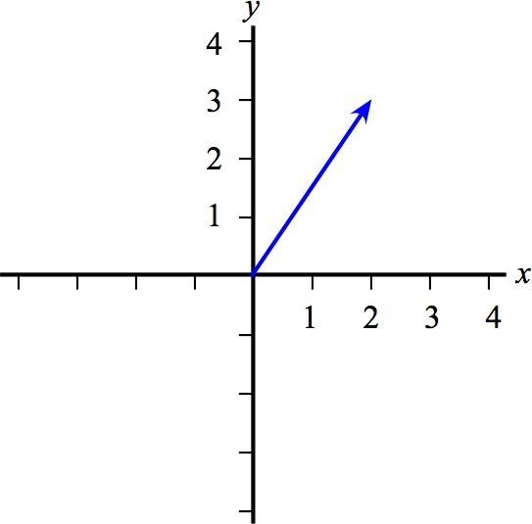
Checking Understanding
What are the x- and y-components of these vectors?
3, 2
2, 3
−3, 2
2, −3
−3, −2
Slide 3-23
Notes:
Answer: B

Slide 16
Checking Understanding
What are the x- and y-components of these vectors?
3, 2
2, 3
−3, 2
2, −3
−3, −2
Slide 3-23
Notes:
Answer: B

Slide 17
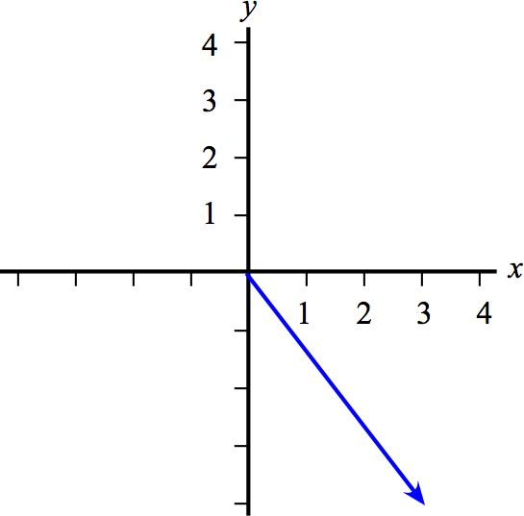
Checking Understanding
What are the x- and y-components of these vectors?
3, −1
3, −4
−3, 3
4, −3
−3, −4
Slide 3-25
Notes:
Answer: B

Slide 18
Answer
What are the x- and y-components of these vectors?
3, −1
3, −4
−3, 3
4, −3
−3, −4
Slide 3-26
Notes:
Answer: B

Slide 19
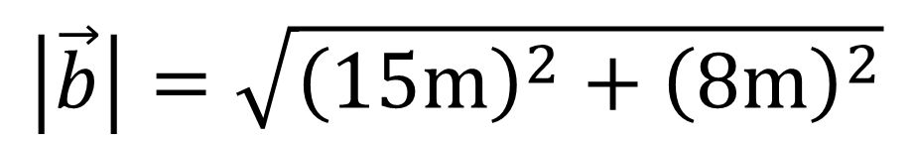
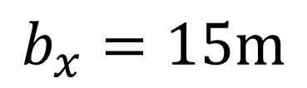

What is the magnitude of a vector with components (15 m, 8 m)?
$$b_{y}=8\text{m}$$
$$b_{x}=15\text{m}$$
$$\left|\vec{b}\right|=\sqrt{{\left(15\text{m}\right)}^{2}+{\left(8\text{m}\right)}^{2}}$$
These bars take the magnitude of the vector argument

Slide 20

Vectors and Trigonometry
The legs of a triangle depend on which angle were talking about
hypotenuse
opposite
$$θ$$
adjacent

Slide 21

Vectors and Trigonometry
The legs of a triangle depend on which angle were talking about
$$θ$$
hypotenuse
adjacent
opposite

Slide 22
Vectors and Trigonometry
The legs of a triangle depend on which angle were talking about
hypotenuse
opposite
$$θ$$
adjacent

Slide 23
Vectors and Trigonometry
The legs of a triangle depend on which angle were talking about
$$θ$$
hypotenuse
adjacent
opposite

Slide 24
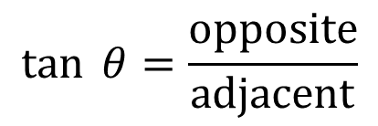

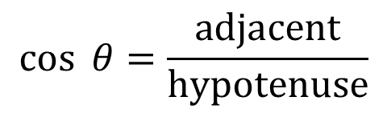
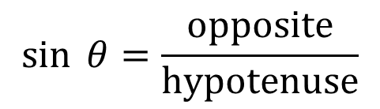
Using trig. functions
SOH
CAH
TOA
$$\sin{ θ=\frac{\text{opposite}}{\text{hypotenuse}}}$$
$$\cos{ θ=\frac{\text{adjacent}}{\text{hypotenuse}}}$$
$$\tan{ θ=\frac{\text{opposite}}{\text{adjacent}}}$$
$$θ$$
hypotenuse
adjacent
opposite

Slide 25



Consider the vector b⃗ with magnitude 4.00 m at an angle 23.5∘ north of east. What is the x component bx of this vector?
4 m
$$\vec{b}$$
23.5 Degrees
$$\cos{ 23.5=\frac{b_{x}}{\text{4}\text{m}}}$$
$$b_{x}$$

Slide 26



Consider the vector b⃗ with length 4.00 m at an angle 23.5∘ north of east. What is the y component by of this vector?
4 m
$$\vec{b}$$
23.5 Degrees
$$\sin{ 23.5=\frac{b_{y}}{\text{4}\text{m}}}$$
$$b_{x}$$

Slide 27
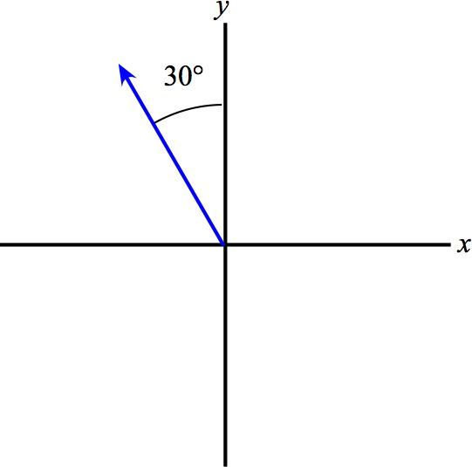
Checking Understanding
The following vectors have length 4.0 units.
What are the x- and y-components of these vectors?
3.5, 2.0
−2.0, 3.5
−3.5, 2.0
2.0, −3.5
−3.5, −2.0
Slide 3-27
Notes:
Answer: B

Slide 28
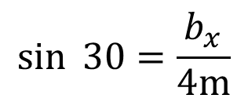

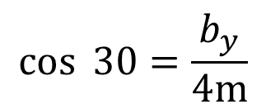

Answer
The following vector has a length of 4.0 units.
What are the x- and y-components of this vector?
$$\vec{b}$$
$$\cos{ 30=\frac{b_{y}}{\text{4}\text{m}}}$$
$${30}^{°}$$
3.5, 2.0
−2.0, 3.5
−3.5, 2.0
2.0, −3.5
−3.5, −2.0
$$\sin{ 30=\frac{b_{x}}{\text{4}\text{m}}}$$
Slide 3-28
Notes:
Answer: B

Slide 29
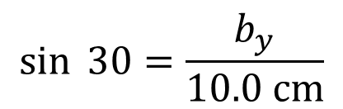
What is the length of the shadow cast on the vertical screen by your 10.0 cm hand if it is held at an angle of θ=30.0∘ above horizontal?
light
10.0 cm
hand
30 Degrees
$$\sin{ 30=\frac{b_{y}}{\text{10.0 }\text{cm}}}$$

Slide 30




What is the angle above the x axis (i.e., "north of east") for a vector with components (15 m, 8 m)?
$$b_{y}=8\text{m}$$
$$\tan{ θ=\frac{\text{opposite}}{\text{adjacent}}}$$
$$b_{x}=15\text{m}$$
$$θ=\tan^{−1}\left(\frac{8\text{m}}{15\text{m}}\right)$$

Slide 31
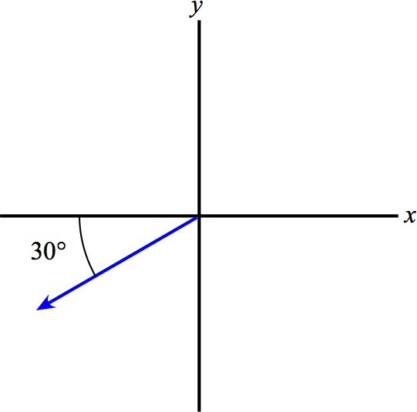
Checking Understanding
The following vectors have length 4.0 units.
What are the x- and y-components of these vectors?
3.5, 2.0
2.0, 3.5
−3.5, 2.0
2.0, −3.5
−3.5, −2.0
Slide 3-29
Notes:
Answer: E

Slide 32
Answer
The following vectors have length 4.0 units.
What are the x- and y-components of these vectors?
3.5, 2.0
2.0, 3.5
−3.5, 2.0
2.0, −3.5
−3.5, −2.0
Slide 3-30
Notes:
Answer: E

Slide 33
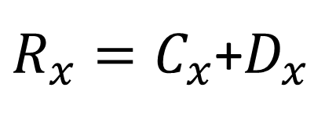
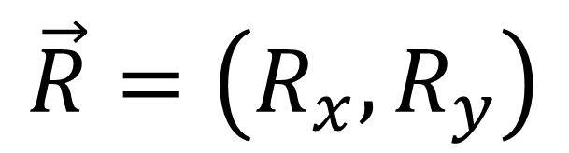
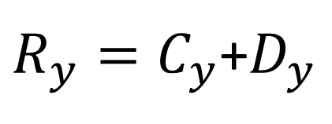
Consider the two vectors C⃗ and D⃗ , defined as follows:
C⃗ =(2.35,−4.27) and D⃗ =(−1.30,−2.21).
What is the resultant vector R⃗ =C⃗ +D⃗ ?
$R_{x}=C_{x}$+$D_{x}$
$R_{y}=C_{y}$+$D_{y}$
$$\vec{R}=\left(R_{x},R_{y}\right)$$

Slide 34
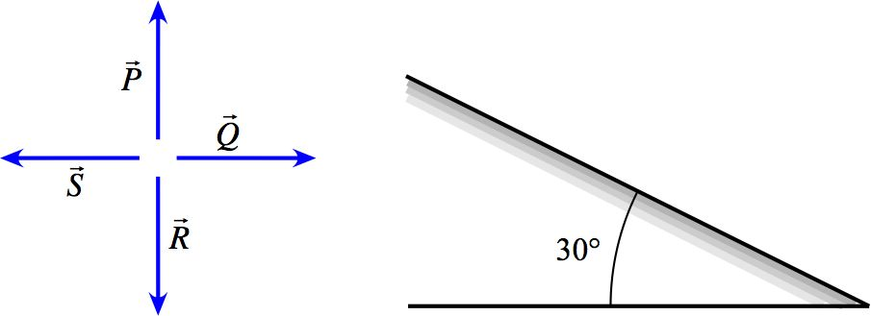
Example Problem
The labeled vectors each have length 4 units. For each vector, what is the component parallel to the ramp?
The labeled vectors each have length 4 units. For each vector, what is the component perpendicular to the ramp?
RAMP
Slide 3-31

Slide 35




Example Problem
The labeled vectors each have length 4 units. For each vector, what is the component parallel to the ramp?
The labeled vectors each have length 4 units. For each vector, what is the component perpendicular to the ramp?
$$P_{perp}=4\text{m}\cos{{30}^{°}}$$
$${30}^{°}$$
$${30}^{°}$$
$$P_{par}=4\text{m}\sin{{30}^{°}}$$
Slide 3-31

Slide 36


Example Problem
The labeled vectors each have length 4 units. For each vector, what is the component parallel to the ramp?
The labeled vectors each have length 4 units. For each vector, what is the component perpendicular to the ramp?
$$S_{perp}=4\text{m}\sin{{30}^{°}}$$
$${30}^{°}$$
$$S_{par}=4\text{m}\cos{{30}^{°}}$$
Slide 3-31

Slide 37



Example Problem
The labeled vectors each have length 4 units. For each vector, what is the component parallel to the ramp?
The labeled vectors each have length 4 units. For each vector, what is the component perpendicular to the ramp?
$$R_{par}=4\text{m}\sin{{30}^{°}}$$
$${30}^{°}$$
$${30}^{°}$$
$$R_{perp}=4\text{m}\cos{{30}^{°}}$$
Slide 3-31

Slide 38


Example Problem
The labeled vectors each have length 4 units. For each vector, what is the component parallel to the ramp?
The labeled vectors each have length 4 units. For each vector, what is the component perpendicular to the ramp?
$$Q_{perp}=4\text{m}\sin{{30}^{°}}$$
$${30}^{°}$$
$${30}^{°}$$
$$Q_{par}=4\text{m}\cos{{30}^{°}}$$
Slide 3-31

Slide 39

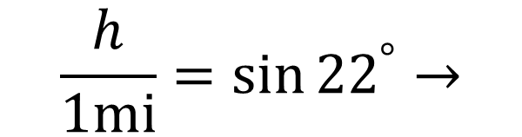


Example Problems
The Manitou Incline was an extremely steep cog railway in the Colorado mountains; cars climbed at a typical angle of 22° with respect to the horizontal. What was the vertical elevation change for the one-mile run along the track?
$$1\text{mi}$$
$$h$$
22°
$$\frac{h}{1\text{mi}}=\sin{{22}^{°}}→$$
$$h=1\text{mi} \sin{{22}^{°}}$$
Slide 3-32

Slide 40
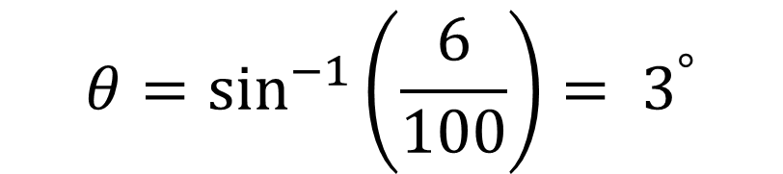
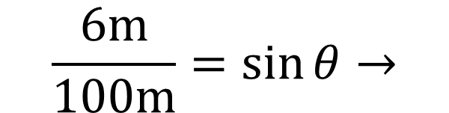

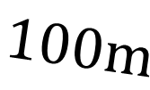

Example Problems
The maximum grade of interstate highways in the United States is 6.0%, meaning a 6.0 meter rise for 100 m of horizontal travel.
What is the angle with respect to the horizontal of the maximum grade?
$$1\text{00}\text{m}$$
$$6\text{m}$$
$$θ$$
$$θ=\sin^{−1}\left(\frac{6}{100}\right)= 3^{°}$$
$$\frac{6\text{m}}{100\text{m}}=\sin{θ}→$$
Slide 3-32

Slide 41

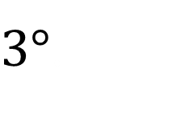
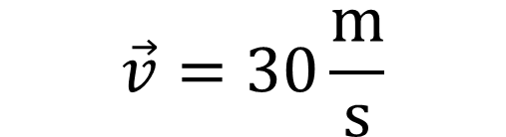

Example Problems
The maximum grade of interstate highways in the United States is 6.0%, meaning a 6.0 meter rise for 100 m of horizontal travel.
What is the angle with respect to the horizontal of the maximum grade?
Suppose a car is driving up a 6.0% grade on a mountain road at 67 mph (30m/s). How many seconds does it take the car to increase its height by 100 m?
$$\vec{v}=30\frac{\text{m}}{\text{s}}$$
Find displacement
$$100\text{m}$$
$3﷮°$.
Slide 3-32

Slide 42
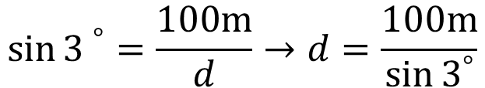




Example Problems
The maximum grade of interstate highways in the United States is 6.0%, meaning a 6.0 meter rise for 100 m of horizontal travel.
What is the angle with respect to the horizontal of the maximum grade?
Suppose a car is driving up a 6.0% grade on a mountain road at 67 mph (30m/s). How many seconds does it take the car to increase its height by 100 m?
$$\sin{{3 }^{°}=\frac{100\text{m}}{d}}→d=\frac{100\text{m}}{\sin{3^{°}}}$$
$$\vec{v}=30\frac{\text{m}}{\text{s}}$$
OR
$$\sin{3^{°} }={\frac{6\text{m}}{\text{100}\text{m}}=\frac{100\text{m}}{d}}$$
$$100\text{m}$$
Find displacement
$3﷮°$.
Slide 3-32

Slide 43



Vector Addition
When adding vectors, bring the tip of one to the tail of the other
$$\vec{a}+\vec{b}$$
$$\vec{a}$$
$$\vec{b}$$

Slide 44
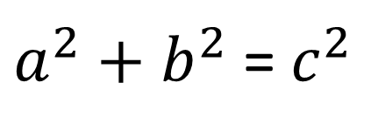
Application of vector addition 2D
Throw a ball up while moving on the motorcycle
Speed of ball relative to ground
y(meters)
?
10 m/s
2 m/s
5
10
x(meters)
Use the Pythagorean Theorem
$a^{2}+b^{2}$ =${ c}^{2}$

Slide 45
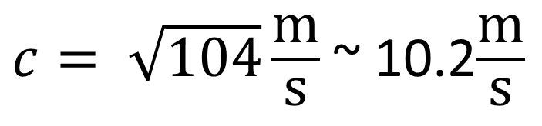
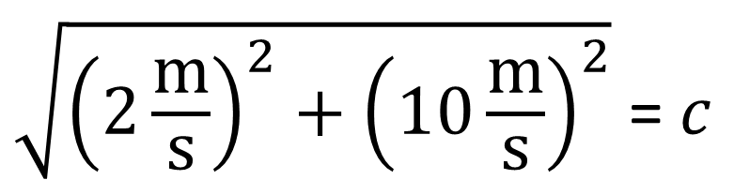
What is the ball’s speed?
Solve for c
$\sqrt{{\left(2\frac{\text{m}}{\text{s}}\right)}^{2}+{\left(10\frac{\text{m}}{\text{s}}\right)}^{2}}$ =$c$
2 m/s
10 m/s
$c= \sqrt{104}\frac{\text{m}}{\text{s}}$ ~ 10.2$\frac{\text{m}}{\text{s}}$

Slide 46
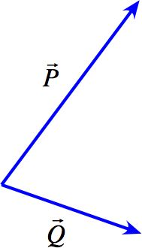

Checking Understanding
Which of the vectors below best represents the vector sum P + Q?
→
→
Slide 3-16
Notes:
Answer: A

Slide 47

Answer
Which of the vectors below best represents the vector sum P + Q?
→
→
A.
Slide 3-17
Notes:
Answer: A

Slide 48
Answer
Which of the vectors below best represents the vector sum P + Q?
→
→
Slide 3-17
Notes:
Answer: A

Slide 49

Slide 3-14

Slide 50


Vector Subtraction
$$\vec{a}$$
Flip this vector
$$−\vec{b}$$

Slide 51

Vector Subtraction
$$\vec{a}$$
$$\vec{a}−\vec{b}$$
$$−\vec{b}$$

Slide 52
Checking Understanding
Which of the vectors below best represents the difference P – Q?
→
→
Slide 3-18
Notes:
Answer: B

Slide 53

Answer
Which of the vectors below best represents the difference P – Q?
→
→
B.
Slide 3-19
Notes:
Answer: B

Slide 54
Checking Understanding
Which of the vectors below best represents the difference Q – P?
→
→
Slide 3-20
Notes:
Answer: C

Slide 55

Answer
Which of the vectors below best represents the difference Q – P?
→
→
C.
Slide 3-21
Notes:
Answer: C

Slide 56
Using Vectors
Examples of vectors:
Position
Velocity
Acceleration

Slide 57

Slide 3-15

Slide 58



The Acceleration Vector
Tilted system
$$\vec{a}$$
$$\vec{v}$$

Slide 59

Vectors in Motion Diagrams
Acceleration is a change in velocity
$$a_{x}=\frac{∆v_{x}}{∆t}=\frac{v_{f−}v_{i}}{t_{f−}t_{i}}$$
0s
1s
2s

Slide 60




Vectors in Motion Diagrams
Acceleration is vector too
$$\vec{a}=\frac{∆\vec{v}}{∆t}$$
0s
3 m/s
4 m/s
$$\vec{a}=\frac{{\vec{v}}_{f}−{\vec{v}}_{i}}{2\text{s}\text{−0}\text{s}}$$
$${\vec{v}}_{i}$$
$${\vec{v}}_{f}$$
1s
5 m/s
2s

Slide 61






Vectors in Motion Diagrams
Acceleration is vector too
$${−\vec{v}}_{i}$$
$$\vec{a}=\frac{{\vec{v}}_{f}−{\vec{v}}_{i}}{2\text{s}}$$
$$\vec{a}$$
$$\vec{a}=\frac{\left(5\text{m}\text{/}\text{s},0\text{m}\text{/}\text{s}\right)−\left(3\text{m}\text{/}\text{s},−4\text{m}\text{/}\text{s}\right)}{2\text{s}}$$
$${\vec{v}}_{f}$$
$$\vec{a}=\frac{\left(2\text{m}\text{/}\text{s}, 4\text{m}\text{/}\text{s}\right)}{2\text{s}}=\left(1\text{m}\text{/}\text{s}\text{/}\text{s},2\text{m}\text{/}\text{s}\text{/}\text{s}\right)=\left(1\frac{\text{m}}{{\text{s}}^{2}},2\frac{\text{m}}{{\text{s}}^{2}}\right)$$

Slide 62


Checking Understanding
The diagram below shows two successive positions of a particle; it’s a segment of a full motion diagram. Which of the acceleration vectors best represents the acceleration between v_{i} and v_{f}?
→
→
Slide 3-33
Notes:
Answer: D

Slide 63

Answer
The diagram below shows two successive positions of a particle; it’s a segment of a full motion diagram. Which of the acceleration vectors best represents the acceleration between v_{i} and v_{f}?
→
→
D.
Slide 3-34
Notes:
Answer: D

Slide 64


Example Problems: Motion on a Ramp
A new ski area has opened that emphasizes the extreme nature of the skiing possible on its slopes. Suppose an ad intones “Free fall skydiving is the greatest rush you can experience…but we’ll take you as close as you can get on land. When you tip your skis down the slope of our steepest runs, you can accelerate at up to 75% of the acceleration you’d experience in free fall.” What angle slope could give such an acceleration?
$$θ$$
Slide 3-35

Slide 65








Example Problems: Motion on a Ramp
A new ski area has opened that emphasizes the extreme nature of the skiing possible on its slopes. Suppose an ad intones “Free fall skydiving is the greatest rush you can experience…but we’ll take you as close as you can get on land. When you tip your skis down the slope of our steepest runs, you can accelerate at up to 75% of the acceleration you’d experience in free fall.” What angle slope could give such an acceleration?
$$y$$
$$x$$
$$.75g$$
$$g$$
$$\sin{θ=\frac{.75g}{g}}$$
$$θ={\sin^{−1}{.75}}$$
$$θ$$
Slide 3-35

Slide 66


Example Problems: Motion on a Ramp
Ski jumpers go down a long slope on slippery skis, achieving a high speed before launching into air. The “in-run” is essentially a ramp, which jumpers slide down to achieve the necessary speed. A particular ski jump has a ramp length of 120 m tipped at 21° with respect to the horizontal. What is the highest speed that a jumper could reach at the bottom of such a ramp?
$$120\text{m}$$
$${21}^{°}$$
Slide 3-35

Slide 67






Example Problems: Motion on a Ramp
Ski jumpers go down a long slope on slippery skis, achieving a high speed before launching into air. The “in-run” is essentially a ramp, which jumpers slide down to achieve the necessary speed. A particular ski jump has a ramp length of 120 m tipped at 21° with respect to the horizontal. What is the highest speed that a jumper could reach at the bottom of such a ramp?
What fraction $g$ will the skier feel?
$$a$$
$$\sin{{21}^{°}=\frac{a}{g}=.8367}$$
$$120\text{m}$$
$$g$$
$${21}^{°}$$
Slide 3-35

Slide 68






Example Problems: Motion on a Ramp
Ski jumpers go down a long slope on slippery skis, achieving a high speed before launching into air. The “in-run” is essentially a ramp, which jumpers slide down to achieve the necessary speed. A particular ski jump has a ramp length of 120 m tipped at 21° with respect to the horizontal. What is the highest speed that a jumper could reach at the bottom of such a ramp?
Use 1-D kinematic equation to find the
Final velocity at the end of 120m
$$v_{f}^{2}=v_{i}^{2}+2a∆x$$
$$a$$
$$v_{f}^{2}=2\left(.8367∙9.8\frac{\text{m}}{s^{2}}\right)∙120\text{m}$$
$$120\text{m}$$
$$g$$
$${21}^{°}$$
Slide 3-35

Slide 69



Motion in 2 Dimensions
Projectile Motion
$${\vec{v}}_{i}$$
$$v_{y}$$
$$v_{x}$$

Slide 70


Projectile Motion
The horizontal motion is constant; the vertical motion is free fall:
The horizontal and vertical components of the motion are independent.
Slide 3-37

Slide 71




Motion in 2 Dimensions
Projectile Motion
Each dimension independently follows the 1D kinematic equations
$$y_{f}=y_{i}+{\left(v_{y}\right)}_{i}∆t+\frac{1}{2}a_{y}{\left(∆t\right)}^{2}$$
$$v_{y}$$
$$x_{f}=x_{i}+{\left(v_{x}\right)}_{i}∆t+\frac{1}{2}a_{x}{\left(∆t\right)}^{2}$$
$$v_{x}$$

Slide 72
Reading Quiz
The acceleration vector of a particle in projectile motion
points along the path of the particle.
is directed horizontally.
vanishes at the particle’s highest point.
is directed down at all times.
is zero.
Slide 3-9
Notes:
Answer: D

Slide 73
Answer
The acceleration vector of a particle in projectile motion
points along the path of the particle.
is directed horizontally.
vanishes at the particle’s highest point.
is directed down at all times.
is zero.
Slide 3-10
Notes:
Answer: D

Slide 74

Slide 3-38

Slide 75
Slide 3-39

Slide 76
Example Problem: Projectile Motion
In the movie Road Trip, some students are seeking to jump a car across a gap in a bridge. One student, who professes to know what he is talking about (“Of course I’m sure—with physics, I’m always sure.”), says that they can easily make the jump. He gives the following data: The car weighs 2100 pounds, with passengers and luggage. Right before the gap, there’s a ramp that will launch the car at an angle of 30°. The gap is 10 feet wide. He then suggests that they should drive the car at a speed of 50 mph in order to make the jump.
If the car actually went airborne at a speed of 50 mph at an angle of 30° with respect to the horizontal, how far would it travel before landing?
Does the mass of the car make any difference in your calculation?
Slide 3-40

Slide 77


Example Problem: Projectile Motion
The car weighs 2100 pounds, with passengers and luggage. Right before the gap, there’s a ramp that will launch the car at an angle of 30°. The gap is 10 feet wide. He then suggests that they should drive the car at a speed of 50 mph in order to make the jump.
If the car actually went airborne at a speed of 50 mph at an angle of 30° with respect to the horizontal, how far would it travel before landing?
Does the mass of the car make any difference in your calculation?
$$\vec{v}=50\text{mph}$$
10ft
$${30}^{°}$$
Slide 3-40

Slide 78







Example Problem: Projectile Motion
The car weighs 2100 pounds, with passengers and luggage. Right before the gap, there’s a ramp that will launch the car at an angle of 30°. The gap is 10 feet wide. He then suggests that they should drive the car at a speed of 50 mph in order to make the jump.
If the car actually went airborne at a speed of 50 mph at an angle of 30° with respect to the horizontal, how far would it travel before landing?
Does the mass of the car make any difference in your calculation?
$$\vec{v}=50\text{mph}\text{, }{150}^{°}\text{off} +x\text{−}\text{axis}$$
$$v_{y}$$
$$v_{x}$$
10ft
$${30}^{°}$$
0
$$∆y=v_{iy}t+\frac{1}{2}gt^{2}→$$
$$0=v_{iy}t+\frac{1}{2}gt^{2}$$
$$t=\frac{2v_{iy}}{g}=\frac{2∙50\text{mph}∙\sin{{30}^{°}}}{g}$$
Find the amount of time the car spends in the air
Slide 3-40

Slide 79





Example Problem: Projectile Motion
The car weighs 2100 pounds, with passengers and luggage. Right before the gap, there’s a ramp that will launch the car at an angle of 30°. The gap is 10 feet wide. He then suggests that they should drive the car at a speed of 50 mph in order to make the jump.
If the car actually went airborne at a speed of 50 mph at an angle of 30° with respect to the horizontal, how far would it travel before landing?
Does the mass of the car make any difference in your calculation?
$$\vec{v}=50\text{mph}\text{, }{150}^{°}\text{off} +x\text{−}\text{axis}$$
$$v_{y}$$
$$v_{x}$$
10ft
$${30}^{°}$$
Use that time to find how far he went horizontally before he hit the ground with the horizontal speed = distance/time formula
$$d=v_{x}t$$
Did they make it?
Slide 3-40

Slide 80


Example Problem: Broad Jumps
A grasshopper can jump a distance of 30 in (0.76 m) from a standing start. If the grasshopper takes off at the optimal angle for maximum distance of the jump, what is the initial speed of the jump? Most animals jump at a lower angle than 45°. Suppose the grasshopper takes off at 30° from the horizontal. What jump speed is necessary to reach the noted distance?
Same as car jump problem
$${30}^{°}$$
Slide 3-41

Slide 81
Example Problem
Alan Shepard took a golf ball to the moon during one of the Apollo missions, and used a makeshift club to hit the ball a great distance. He described the shot as going for “miles and miles.” A reasonable golf tee shot leaves the club at a speed of 64 m/s. Suppose you hit the ball at this speed at an angle of 30° with the horizontal in the moon’s gravitational acceleration of 1.6 m/s². How long is the ball in the air? How far would the shot go?
Same as car jump problem
Slide 3-42

Slide 82


Circular Motion
Uniform circular motion
$$\vec{a}$$
$$\vec{v}$$
Not speeding up but changing directions

Slide 83



Circular Motion
There is an acceleration because the velocity is changing direction.
$$\left|\vec{a}\right|=\frac{{\left|\vec{v}\right|}^{2}}{r}$$
Slide 3-43

Slide 84


Example Problems: Circular Motion
Two friends are comparing the acceleration of their vehicles. Josh owns a Ford Mustang, which he clocks as doing 0 to 60 mph in a time of 5.6 seconds. Josie has a Mini Cooper that she claims is capable of higher acceleration. When Josh laughs at her, she proceeds to drive her car in a tight circle of 10ft at 13 mph. Which car experiences a higher acceleration?
$$\left|\vec{a}\right|=\frac{\text{88}\text{ft}\text{/}\text{s}\text{−0}\text{ft}\text{/}\text{s}}{5.6\text{s}}=\text{15.71}\frac{\text{ft}}{{\text{s}}^{2}}$$
$$\left|\vec{a}\right|=\frac{{\left(\text{19.1}\text{ft}\text{/}\text{s}\right)}^{2}}{10\text{ft}}=\text{36.5}\frac{\text{ft}}{{\text{s}}^{2}}$$
Slide 3-44

Slide 85



Example Problems: Circular Motion
Turning a corner at a typical large intersection in a city means driving your car through a circular arc with a radius of about 25 m. If the maximum advisable acceleration of your vehicle through a turn on wet pavement is 0.40 times the free-fall acceleration, what is the maximum speed at which you should drive through this turn?
$$\left|\vec{a}\right|=\frac{{\left|\vec{v}\right|}^{2}}{r}$$
$$\left|\vec{v}\right|=\sqrt{25\text{m}∙.4∙9.8\frac{\text{m}}{{\text{s}}^{2}}}$$
$$.4∙\left|g\right|=\frac{{\left|\vec{v}\right|}^{2}}{25\text{m}}$$
Slide 3-44

Slide 86


Motion in 2 Dimensions
Circular Motion
$$\vec{v}$$
Centripetal acceleration
$$\vec{a}$$

Slide 87





A garden has a circular path of radius 50m . John starts at the easternmost point on this path, then walks counterclockwise around the path until he is at its southernmost point.
What is the magnitude of John's displacement?
$$b$$
$$c=\sqrt{a^{2}+b^{2}}$$
$$a$$
$$c$$
$$c=\sqrt{5000\text{m}}$$

Slide 88
Reading Quiz
The acceleration vector of a particle in uniform circular motion
points tangent to the circle, in the direction of motion.
points tangent to the circle, opposite the direction of motion.
is zero.
points toward the center of the circle.
points outward from the center of the circle.
Slide 3-11
Notes:
Answer: D

Slide 89
Answer
The acceleration vector of a particle in uniform circular motion
points tangent to the circle, in the direction of motion.
points tangent to the circle, opposite the direction of motion.
is zero.
points toward the center of the circle.
points outward from the center of the circle.
Slide 3-12
Notes:
Answer: D

Slide 90
Relative Motion
Relative Velocity
Plane speed
(relative to wind)
wind
What about plane speed relative to the ground?

Slide 91
Relative Motion
Use vector subtraction to find the
plane speed relative to the ground
Plane speed
(relative to ground)
Plane speed
(relative to wind)
wind

Slide 92

You try to swim directly across the river at a speed of 1.00 m/s. What does your friend see?
Swimming velocity
$$1\frac{\text{m}}{\text{s}}$$
Velocity relative to the shore
Water velocity

Slide 93
This time you try to make it look like your swimming directly across the river to your friend on the shore. What velocity would you need to do this?
Velocity relative to the shore
Swimming velocity
Water velocity

Slide 94

You're driving down the highway late one night at 18m/s when a deer steps onto the road 44m in front of you. Your reaction time before stepping on the brakes is 0.50s , and the maximum acceleration of your car is -11m/s/s
How much distance is between you and the deer when you come to a stop?
What is the maximum speed you could have and still not hit the deer?
$$x_{f}=v_{xi}t+\frac{1}{2}a_{x}t^{2}$$

Slide 95





Example Problems: Relative Motion
An airplane pilot wants to fly due west from Spokane to Seattle. Her plane moves through the air at 200 mph, but the wind is blowing 40 mph due north. In what direction should she point the plane—that is, in what direction should she fly relative to the air?
wind
$$\vec{v}$$
$$θ$$
$$40\text{mph}$$
$$200\text{mph}$$
$$\sin^{−1}{\frac{40}{200}=θ}$$
Slide 3-36

Slide 96

Example Problems: Relative Motion
A skydiver jumps out of an airplane 1000 m directly above his desired landing spot. He quickly reaches a steady speed, falling through the air at 35 m/s. There is a breeze blowing at 7 m/s to the west. At what angle with respect to vertical does he fall? When he lands, what will be his displacement from his desired landing spot?
7 m/s
wind
30 m/s
$$1000\text{m}$$
Slide 3-36

Slide 97
Example Problems: Relative Motion
A skydiver jumps out of an airplane 1000 m directly above his desired landing spot. He quickly reaches a steady speed, falling through the air at 35 m/s. There is a breeze blowing at 7 m/s to the west. At what angle with respect to vertical does he fall? When he lands, what will be his displacement from his desired landing spot?
wind
7 m/s
30 m/s
$$1000\text{m}$$
Slide 3-36

Slide 98
MCAT style question
At the end of the first section of the motion, riders are moving at what approximate speed?
3 m/s
6 m/s
9 m/s
12 m/s

Slide 99
MCAT style question
Suppose the acceleration during the second section of the motion is too large to be comfortable for riders. What change could be made to decrease the acceleration during this section?
reduce the radius of the circular segment
increase the radius of the circular segment
increase the angle of the ramp
increase the length of the ramp

Slide 100
MCAT style question
What is the vertical component of the velocity of the rider just before he/she hits the water?
2.4 m/s
3.4 m/s
5.2 m/s
9.1 m/s

Slide 101
MCAT style question
Suppose the designers of the water slide want to adjust the height above the water so that riders land twice as far away from the bottom of the slide. What would be the necessary height above the water?
1.2 m
1.8 m
2.4 m
3.0 m

Slide 102
MCAT style question
During which section of the motion is the magnitude of the acceleration experienced by a rider the greatest?
first
second
third
They’re all the same

Slide 103

Summary
Slide 3-45

Slide 104

Summary
Slide 3-46

